Slide 1
shark tank project
File created on: 6/28/2025 11:07:03 AM

Slide 2
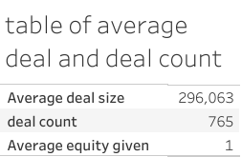

Slide 3
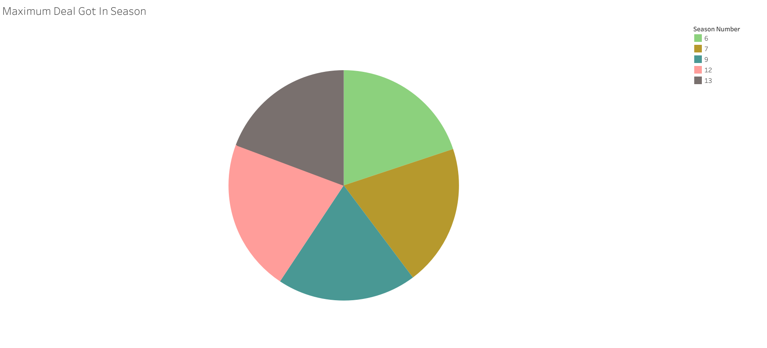

Slide 4


Slide 5
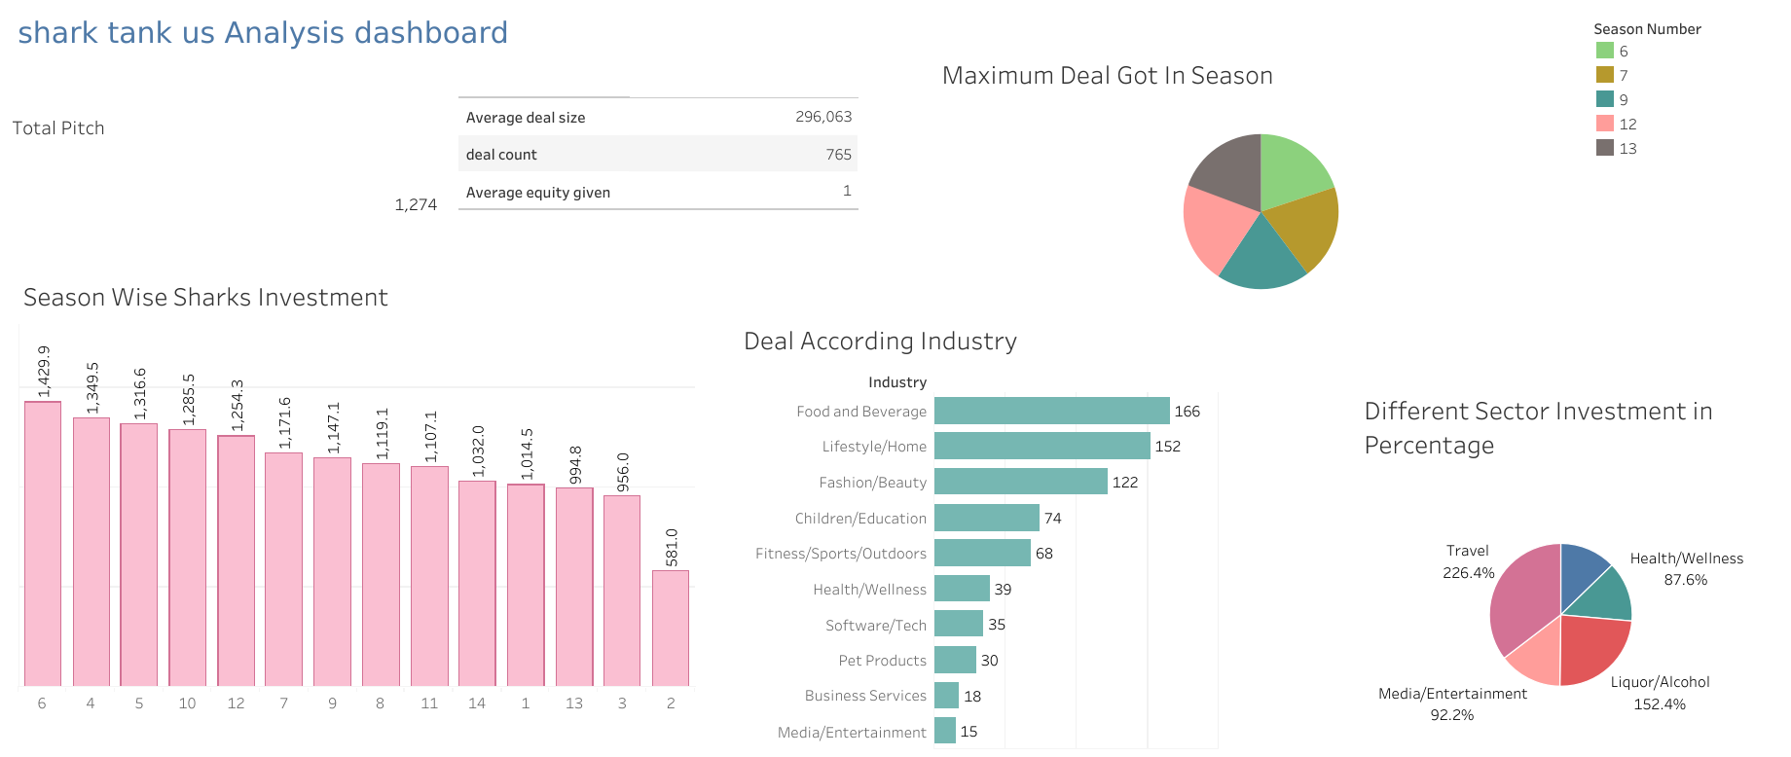

Slide 6


Slide 7
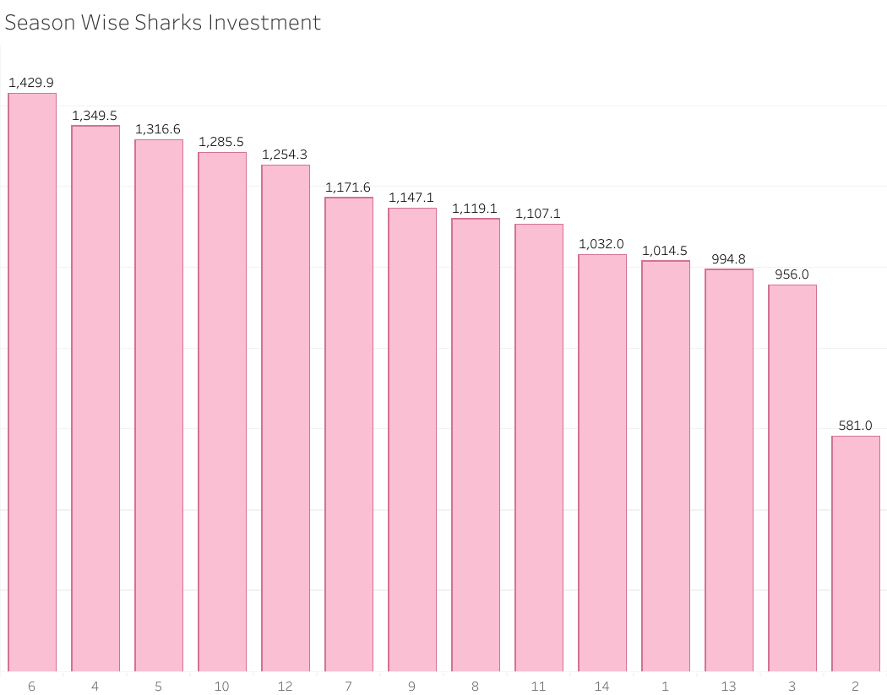

Slide 8
